Slide 1
7 Areas of Technology
Your Name Here
Technology 7
Mr. Poliszuk

Slide 2
Agricultural and Biotechnology
Definition:
How does this impact our society?

Slide 3
Information and Communication
Definition:
How does this impact our society?

Slide 4
Energy and Power
Definition:
How does this impact our society?

Slide 5
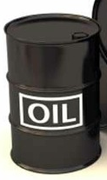
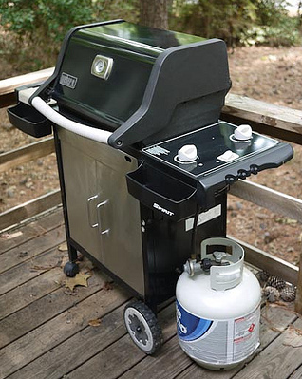
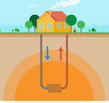
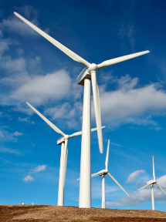
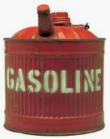
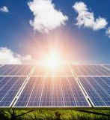
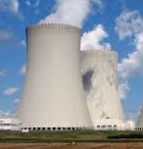
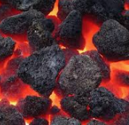
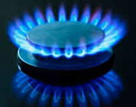
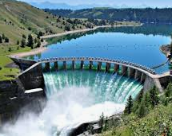
Energy and Power
NON-RENEWABLE ENERGIES | RENEWABLE ENERGIES
Definition: | Definition:
Characteristics and Images: | Characteristics and Images:
Bank:
Wind Power
Gas
Solar Power
Nuclear Power
Oil
Natural Gas
Hydroelectric Power
Propane
Geothermal Power
Coal
Usually Clean for Environment
Can Pollute the Environment
Infinite Resources
Finite Resources
Can Use Over and Over Again
Will Burn and Only Use Once
Produces LOTS of Power
Produces Little Power

Slide 6
Medical
Definition:
How does this impact our society?

Slide 7
Construction
Definition:
How does this impact our society?

Slide 8
Transportation
Definition:
How does this impact our society?

Slide 9
Manufacturing
Definition:
How does this impact our society?

Slide 10
Conclusion
Summarize and discuss the multiple areas of technology and how they impact our society.
Choose an area of technology you would like to work in as career, and explain why you would like to work in that area.

Slide 11
Learning Target: I can… 1. Self-assess my ‘7 Areas of Technology’ project, according to the rubric (criteria for success).
Slides | Meeting Expectations (10-9 pts) | Approaching Expectations (8-6 pts) | Not Meeting Expectations (5-0 pts)
Title Slide | Title, your name, subject, teacher’s name, 7 pictures – one from each area, balanced, neat, clean, professional | Missing 1-3 items | Missing 4 or more items, or did not finish
Agricultural and Biotechnology | Title, correct definition, correct explanation of importance to society, 5-6 pictures, balanced, neat, clean, professional | Missing 1-3 items | Missing 4 or more items, or did not finish
Information and Communication Technology | Title, correct definition, correct explanation of importance to society, 5-6 pictures, balanced, neat, clean, professional | Missing 1-3 items | Missing 4 or more items, or did not finish
Energy and Power Technology | Title, correct definition, correct explanation of importance to society, 5-6 pictures, balanced, neat, clean, professional | Missing 1-3 items | Missing 4 or more items, or did not finish
Medical Technology | Title, correct definition, correct explanation of importance to society, 5-6 pictures, balanced, neat, clean, professional | Missing 1-3 items | Missing 4 or more items, or did not finish
Construction Technology | Title, correct definition, correct explanation of importance to society, 5-6 pictures, balanced, neat, clean, professional | Missing 1-3 items | Missing 4 or more items, or did not finish
Transportation Technology | Title, correct definition, correct explanation of importance to society, 5-6 pictures, balanced, neat, clean, professional | Missing 1-3 items | Missing 4 or more items, or did not finish
Manufacturing Technology | Title, correct definition, correct explanation of importance to society, 5-6 pictures, balanced, neat, clean, professional | Missing 1-3 items | Missing 4 or more items, or did not finish
Conclusion | Accurately answers questions, 5+ complete sentences, no spelling or grammatical errors, 7 pictures – one from each area | Accurately answers questions, 3-4 complete sentences, some spelling or grammatical errors, 4-6 pictures | Does not answer questions, 0-2 complete sentences, several spelling or grammatical errors, 0-3 pictures
Self-Evaluation | Assigns a score for each slide, calculates total score, answers reflection question | Missing 1 item | Missing 2+ items
Total: _____/100 pts

